Slide 1

BIG DATA INTRODUCTION

Slide 2

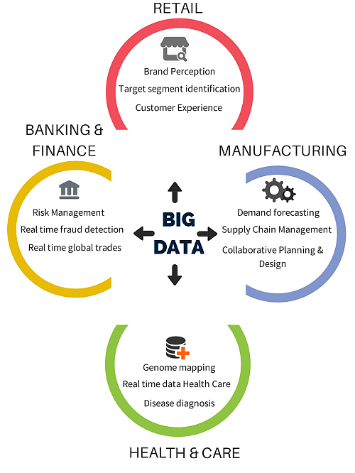
INDUSTRIES USING BIG DATA

Slide 3
Challenges of traditional decision-making
Takes long time to arrive at a decision.
Planning, execution and reporting is not linked
Provides only birds eye view
Unable to make fully informed decisions

Slide 4
Big Data Analytics as a solution
Decision making based on analytics
Capable of handling all type of data
Faster decision making
Detailed view
Comprehensive solution gathering all the aspects

Slide 5
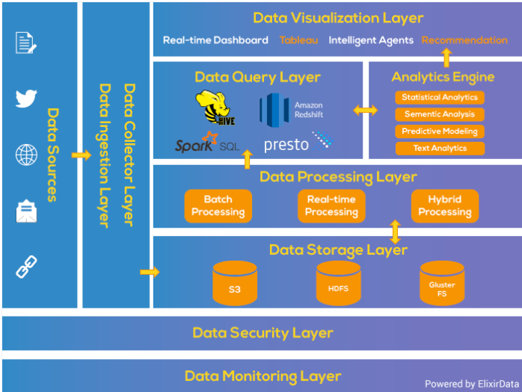
BIG DATA ANALYTICAL PIPELINE
https://www.xenonstack.com/blog/big-data-architecture/

Slide 6
What is Big data
Big Data is a collection of data that is huge in volume, yet growing exponentially with time. It is a data with so large size and complexity that none of traditional data management tools can store it or process it efficiently. Big data is also a data but with huge size.

Slide 7
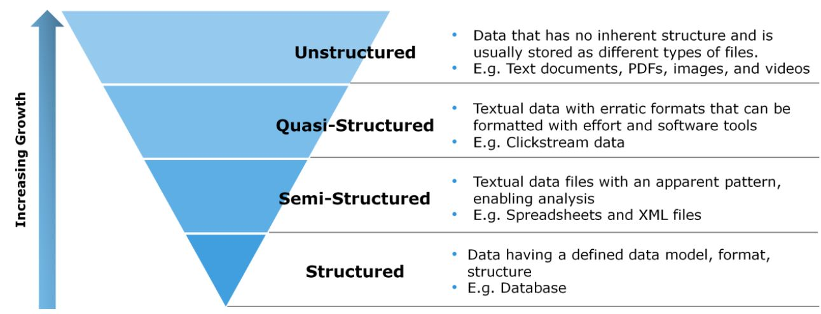
TYPES OF DATA

Slide 8
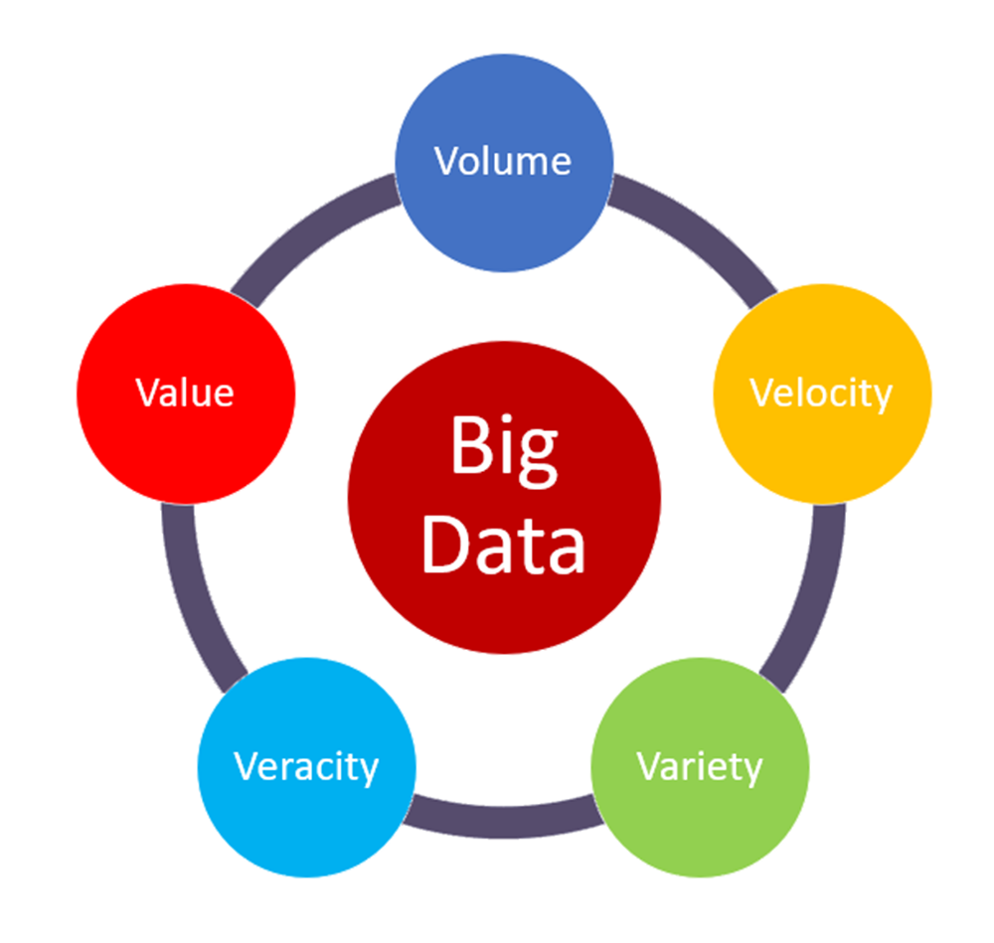
5 V’S OF BIG DATA

Slide 9
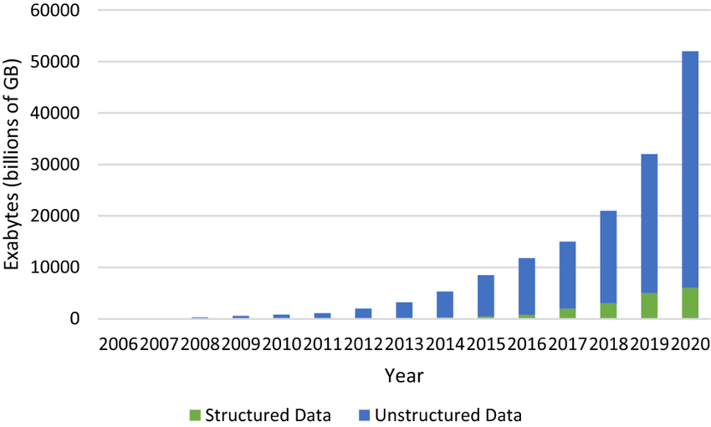
GROWTH OF STRUCTURED DATA VS UNSTRUCTURED DATA

Slide 10
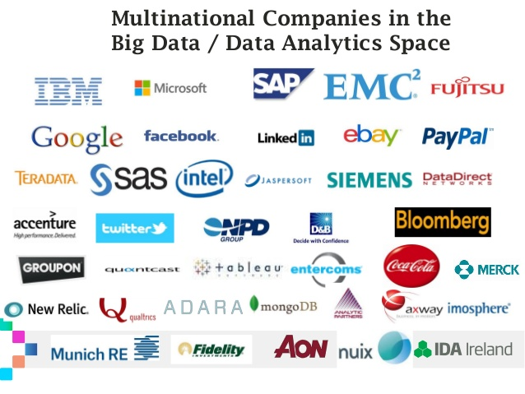

Slide 11
DISTRIBUTED SYSTEM CHALLENGES
Failure Handling: Failure handling can be difficult with distributed systems because some components fail while others continue to function. This can often serve as an advantage to prevent large-scale failures, but it also lead to more complexity when it comes to troubleshooting and debugging.
Concurrency: A common issue occurs when several clients attempt to access a shared resource simultaneously. You must ensure that all resources are safe in a concurrent environment.
Security issues: Data security and sharing have increased risks in distributed computer systems. The network has to be secured, and users must be able to safely access replicated data across multiple locations.
Higher initial infrastructure costs: The initial deployment cost of a distributed system can be higher than a single system. This pricing includes basic network setup issues, such as transmission, high load, and loss of information.

Slide 12
INTRODUCTION TO HADOOP

Slide 13


Hadoop Definition
Apache Hadoop is a frame work collection of open-source software utilities that facilitates using a network of many computers to solve problems involving massive amounts of data and computation. It provides a software framework for distributed storage and processing of big data using the MapReduce programming model
Doug Cutting father” of Hadoop

Slide 14
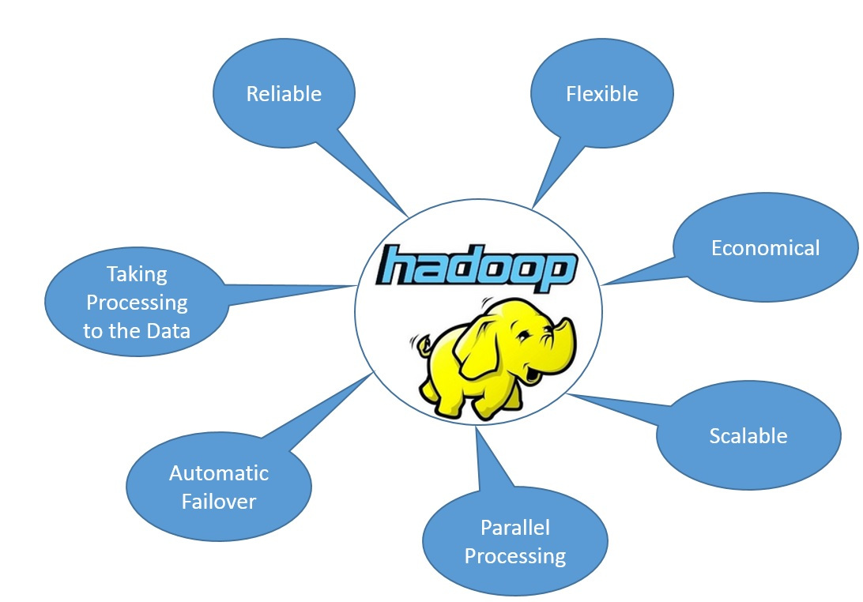
Hadoop Characteristics

Slide 15


Traditional database system Vs Hadoop
Traditional system data moves to programs
Hadoop systems programs moves to data

Slide 16
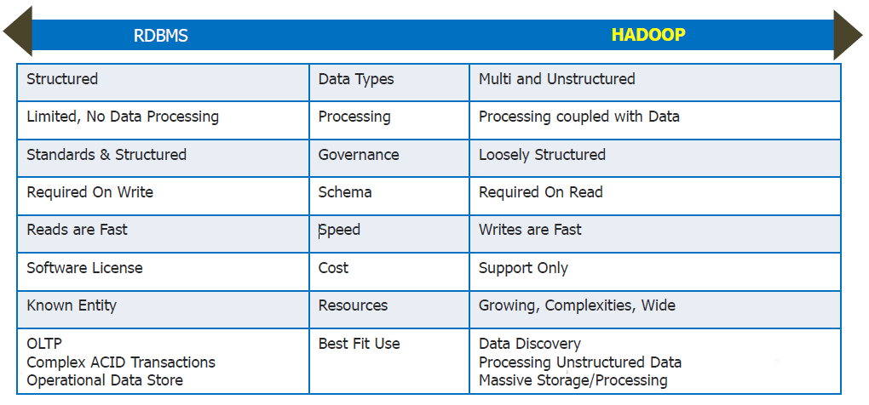
RDBMS Vs Hadoop

Slide 17
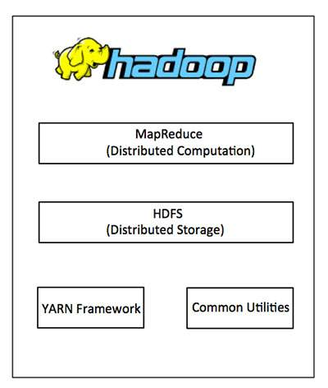
HADOOP CORE COMPONENTS

Slide 18
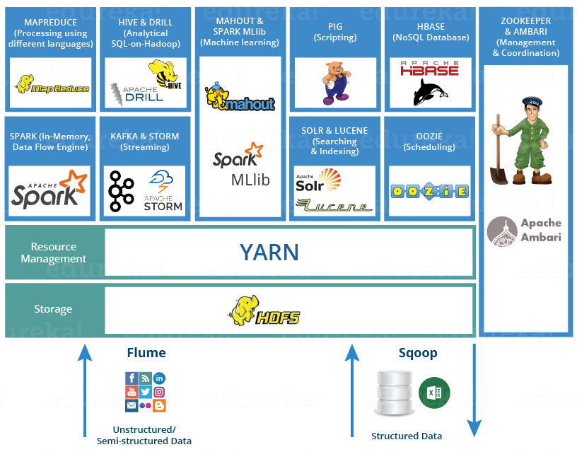
HADOOP COMPONENTS

Slide 19
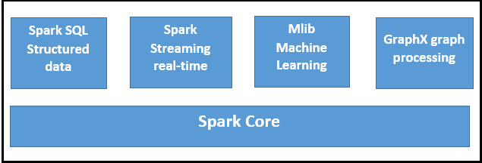
APACHE SPARK

Slide 20
Hadoop cluster
Cluster
Racks
Nodes
Blocks

Slide 21

What is HDFS
HDFS is the storage system of Hadoop framework.
It is suitable for the distributed storage and processing.
Hadoop provides a command interface to interact with HDFS.

Slide 22
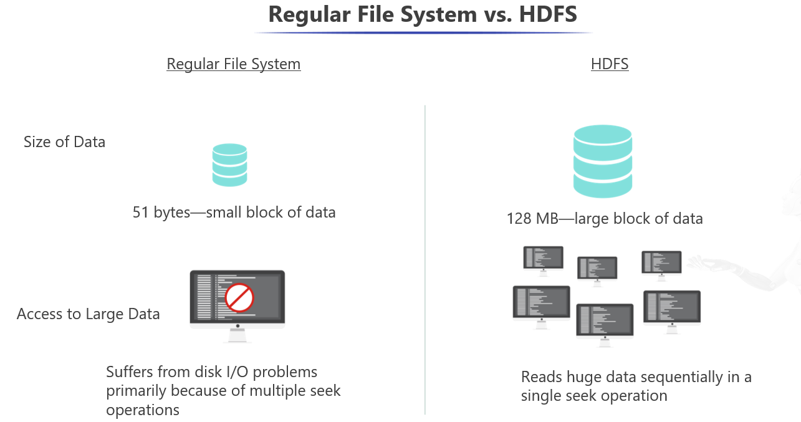

Slide 23
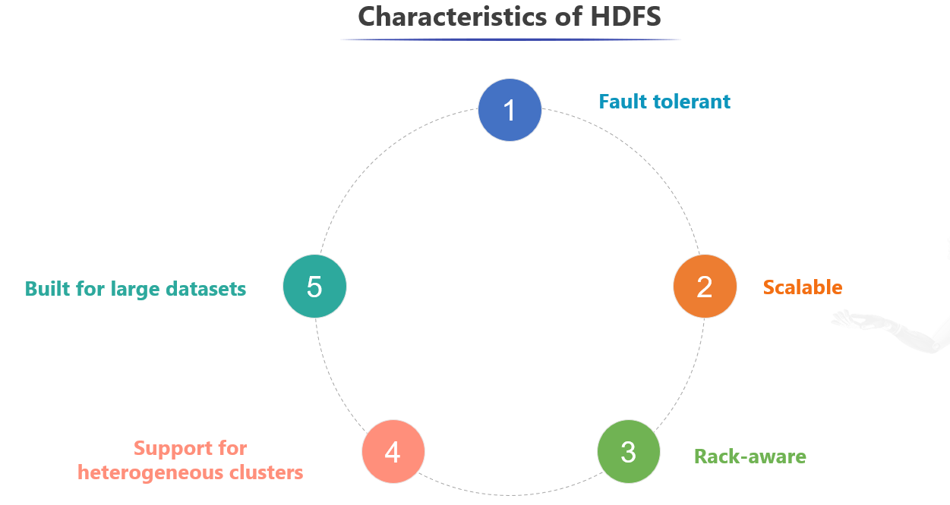

Slide 24
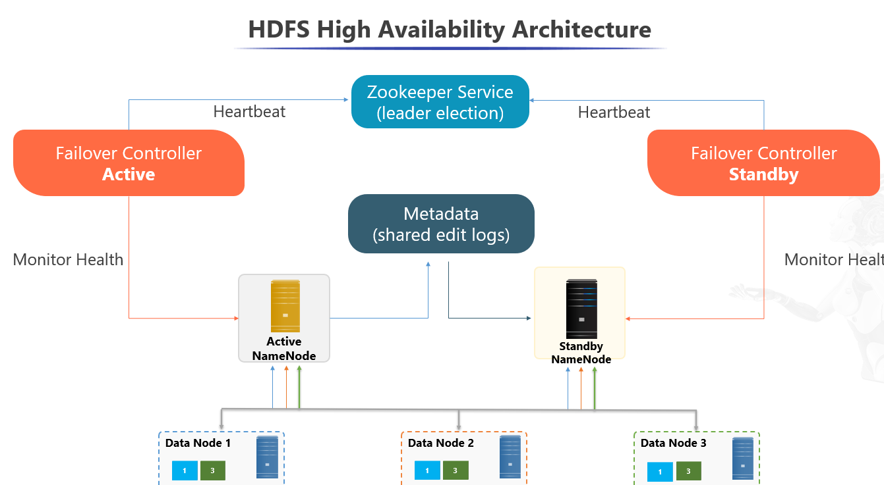

Slide 25
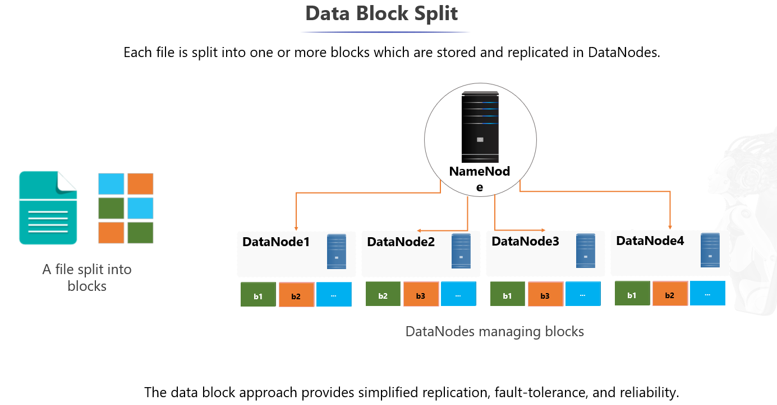

Slide 26
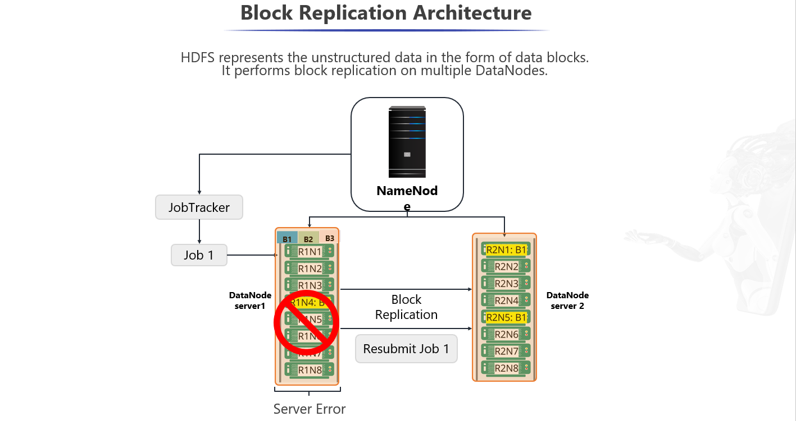

Slide 27

Thank You
Questions.
1) Which of the following is source of unstructured data.
Social media
Banking transaction
Web and server logs
None of the above
2)A bank wants to process 1000 transactions of data per second, which of the 5 vs relate to this.
3) Definition of hadoop ?
4)What is hive?
5) What is hbase?
6) What s pig?
7)What is yarn?
8) Difference between Hadoop and traditional RDBMS
9)Difference between Apache spark and Apache Hadoop
10)Can Hadoop be used for renewable resources detection.

Slide 28
Thank you
Questions.
11) How many blocks are required to store a block of size 586 MB?
12) What is the model of a zookeeper
13) what is the model of hdfs?

